Slide 1
SEAM-STORYTELLING
David M. Boje, Ph.D.
Notes:
Your introductory or title slide should convey the overall “feeling” and focus of your presentation. For instance, I typically present about small-business trends, new business ideas, growth opportunities or other positive trends. In this sample presentation, I’m talking about new business ideas, so I used a sun graphic in this slide template to convey a positive feeling. Personalize this slide template with your company’s logo.
To add a logo to all slides, place it on the Slide Master. To access the Slide Master, on the Themes tab of the Ribbon, click Edit Master and then click Slide Master.
Disclaimer: You understand that Microsoft does not endorse or control the content provided in the following presentation. Microsoft provides this content to you for informational purposes only; it is not intended to be relied upon as business or financial advice. Microsoft does not guarantee or otherwise warrant the accuracy or validity of this information and encourages you to consult with a business or financial professional as appropriate.
RIEVA LESONSKY
Founder and President, GrowBiz Media
Rieva Lesonsky is founder and president of GrowBiz Media, a content and consulting company specializing in covering small businesses and entrepreneurship. A nationally known speaker and authority on entrepreneurship, Lesonsky has been covering America’s entrepreneurs for nearly 30 years. Before co-founding GrowBiz Media, Lesonsky was Editorial Director of Entrepreneur Magazine.

Slide 2
What is AGILE

Slide 3
Becoming Agile
“The Lyon, NY, and Paris stories deomonstrate that JCD has a problem trying out and implmenting the things that work” p. 10
Why? Methds of consulting are too ancient,
Agile→ Strategizing, Perceiving, Testing & Implementing (p. 18) to get past TFW virus (p. 23-25_

Slide 4
Where Dysfunctions come from?
SEAM-STORYTELLING
STORYTELLING DYSFUNCTIONS
STORYTELLING Behaviors
STORYTELLING Hidden Costs
STORYTELLING Structures
TAYLORISM
FAYOLISM
WEBERISM
TFW VIRUS
Notes:
I often use color and graphics to add excitement to a presentation. Just because it’s about business doesn’t mean it has to be staid—you need movement, energy and color, as in this slide template. Use this slide template to illustrate relationships or processes. In this slide, I used it to show how demographic trends create a new consumer group and what products that group purchases. You could also use it to illustrate your sales cycle or relationships among departments in your company.

Slide 5
First Principle of BUSINESS CONSULTING
"All organizations are perfectly designed to get the results they get. To get better results, you need to improve the design of the organization”
→ from Arthur Wayne Jones, as cited in David P. Hanna (1988: 38; 2001: 19)
Notes:
Often misattributed to W. Edward Deming in management, or Paul Batalden in Health policy (YouTube) What Deming did say: "Problems are the fault of the system 96% of the time and individuals 4% of the time." -- W. Edwards Deming
http://quoteinvestigator.com/2013/01/10/watch-your-thoughts/
Published on Jun 27, 2014
Paul Batalden, Medical Director, Senior Fellow, Institute for Healthcare Improvement (IHI), is Professor of Pediatrics, Community and Family Medicine and The Dartmouth Institute for Health Policy and Clinical Practice at Dartmouth Medical School. He teaches about the leadership of improvement of health care
Also see Hanna, David (2001). Leadership for the Ages: Delivering Today's Results, Building Tomorrow's Legacy David P. Hanna
Executive Excellence Pub., 2001 - Business & Economics
Arthur Wayne Jones says he had the insight 3- years ago -- http://ezinearticles.com/?All-Organizations-Are-Perfectly-Designed-to-Get-the-Results-They-Get&id=6560665

Slide 6
SECOND PRINCIPLE
Sow a thought reap a word
Sow a word reap an action
Sow an action reap a habit
Sow a habit reap a character
Sow a character reap a destiny
-- Adapted from Ralph Waldo Emerson

Slide 7
STEP ONE: Find possible client
Print out SMALL BUSINESS APPLICATION (keep signed copy for your report)
Print Confidentiality Agreement (you sign it and give to client, put copy in your report)

Slide 8
STEP TWO: Print out your Major Tools - BEFORE YOU GO TO THE CLIENT WITH AN APPLICATION
explain to client: 4 Leaf Clover
BRING THESE FORMS:
PNAC TOOL form TIME MANAGEMENT TOOL form PAP TOOL form IESP TOOL form COMPETENCY GRID TOOL form PILOTING LOGBOOK
Explain the 3 Axes SEAM MODEL of our Class

Slide 9
Boje’s Piloting Logbook
STEP 3 : Do this today
ADD following forms and these items in it:
Print out the Report Template in case client wants to see it
Print out your Mid-term Check List (what you need to get done by mid-term).
Print out your Final report Check list (what you need to get done by end of term).
Print Client Rating/Grading Sheet for Student's Report (give to client to grade your report)
Please Make SEAM Logbook

Slide 10
TAKE NOTES
STEP FOUR
Phase II do the Mirror Effect meeting (show client excerpts of fieldnotes, hidden costs and revenue calculations, make your expert consultant recommendations)
Phase III (Project) - carry out your proposed Project
Phase IV do 2nd and third ound of DPIE with Mirror Effect and HiddenCost/Hidden Revenue chart each time
Phase V (Final Report) - present and turn in your final report - see Final report Check list
Step FOUR: Learn 4 Phases of your project
You will do Diagnosis-Project-Implementation-Evaluation (DPIE) 3 times (pick small changes that client collaborates with you to do):
Phase I: Diagnosis-Project-Implementation-Evaluation (DPIE) including (Hidden Costs/Hidden Revenue charts); submit mid-term report - see Mid-term Check List
LISTEN to CLIENT

Slide 11
SEAM-STORYTELLING
SEAM is already Full of Storytelling
Pay Attention to Material Storytelling
Strategy is Storytelling
3C’s is already Storytelling
Notes:
I like to speak spontaneously, so I use PowerPoint as an outline to keep me on track. It’s best to keep your PowerPoint text brief, simply reinforcing key points you will talk about at more length. You can use this slide template to convey a series of steps or related points in a short format.

Slide 12
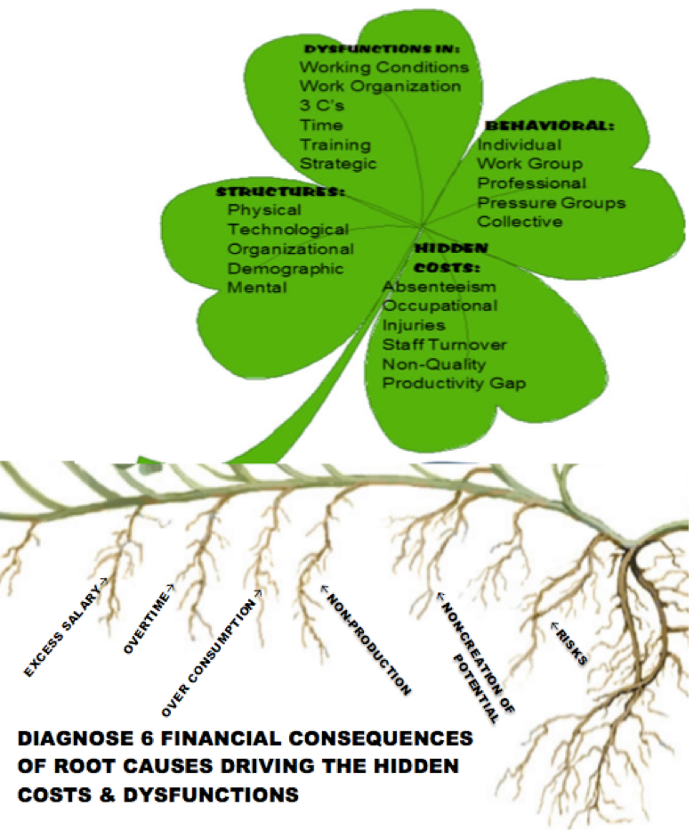
Where to Start Diagnosis

Slide 13
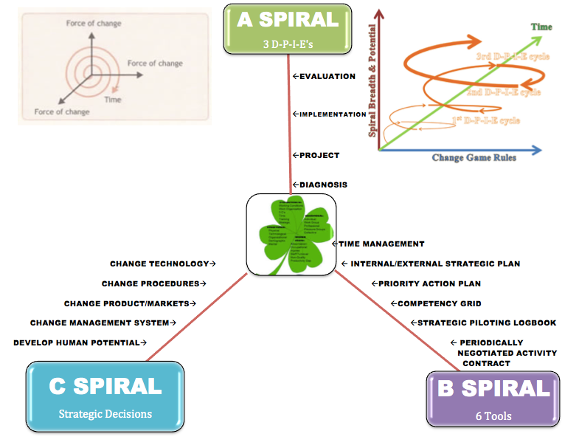
SEAM Consulting Model

Slide 14
Anatomy of SEAM-STORYTELLING
SEAM-STORYTELLING
STORYTELLING Working Conditions
STORYTELLING Behaviors
STORYTELLING Hidden Costs
STORYTELLING Structures
SEAM-STORYTELLING
Quantum
Material
Birth of new Methods
Notes:
I often use color and graphics to add excitement to a presentation. Just because it’s about business doesn’t mean it has to be staid—you need movement, energy and color, as in this slide template. Use this slide template to illustrate relationships or processes. In this slide, I used it to show how demographic trends create a new consumer group and what products that group purchases. You could also use it to illustrate your sales cycle or relationships among departments in your company.

Slide 15
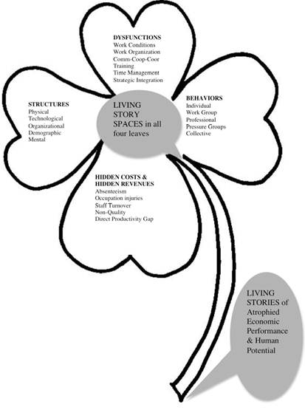
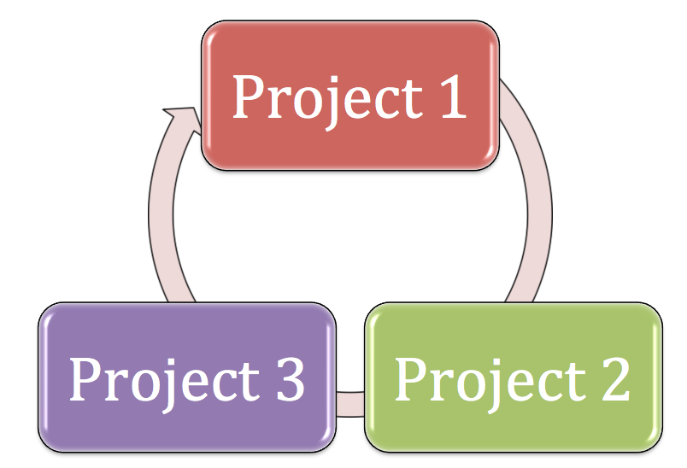
3 times Better than 1
SEAM-STORYTELLING

Slide 16
What’s In SEAM-STORYTELLING?
Sociomateriality
Socioeconomic Accounting
Distrust of Speculative Economics
What’s Out?
Petrified Narrative
Linear Narrative
Dematerial Narrative
Notes:
A plain old bulleted list can get boring, so use graphics to liven it up. An image that conveys what you’re saying in visual format (like this diagram) can reinforce your ideas in the audience’s mind.

Slide 17
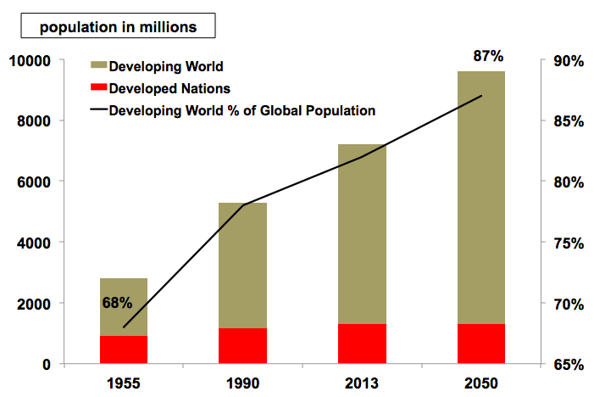
SEAM-STORYTELLING 2015
Socioeconomic
Speculative
Markets
Almost half the wolrd’s population lives on less than $2 a day.
Notes:
I like to use an off-balance layout to keep things from getting too symmetrical. Customize this slide template graphics of your choice, including photos, clip art, your logo or illustrations. Good photos really help cement an idea in the audience’s mind.
This slide is animated to display an appropriate image as you introduce each business type.

Slide 18
Surprisingly, the storytelling is changing
Watch Out: Petrified Narrative
Notes:
Insert a chart in this slide template to illustrate your topic visually, then use bullets or color to call out key findings or points from your chart in a brief format.

Slide 19
Hot Factors in 2016
Demographic Complexity
Speculative Economy Disasters
Bets on the Future
Makes 2016 a Great Time to Start SEAM-STORYTELLING INTERVENOR RESEACH
Notes:
This slide template can show steps, stages or how various elements or factors combine to make one key result or goal. For instance, you could show how various departments in your business work together to make the sale, how key customer groups will all purchase your product, or how different funding sources will provide the total you need. This slide template also makes an excellent concluding slide for your presentation, enabling you to graphically sum up your key points into one final whole.

